Slide 1
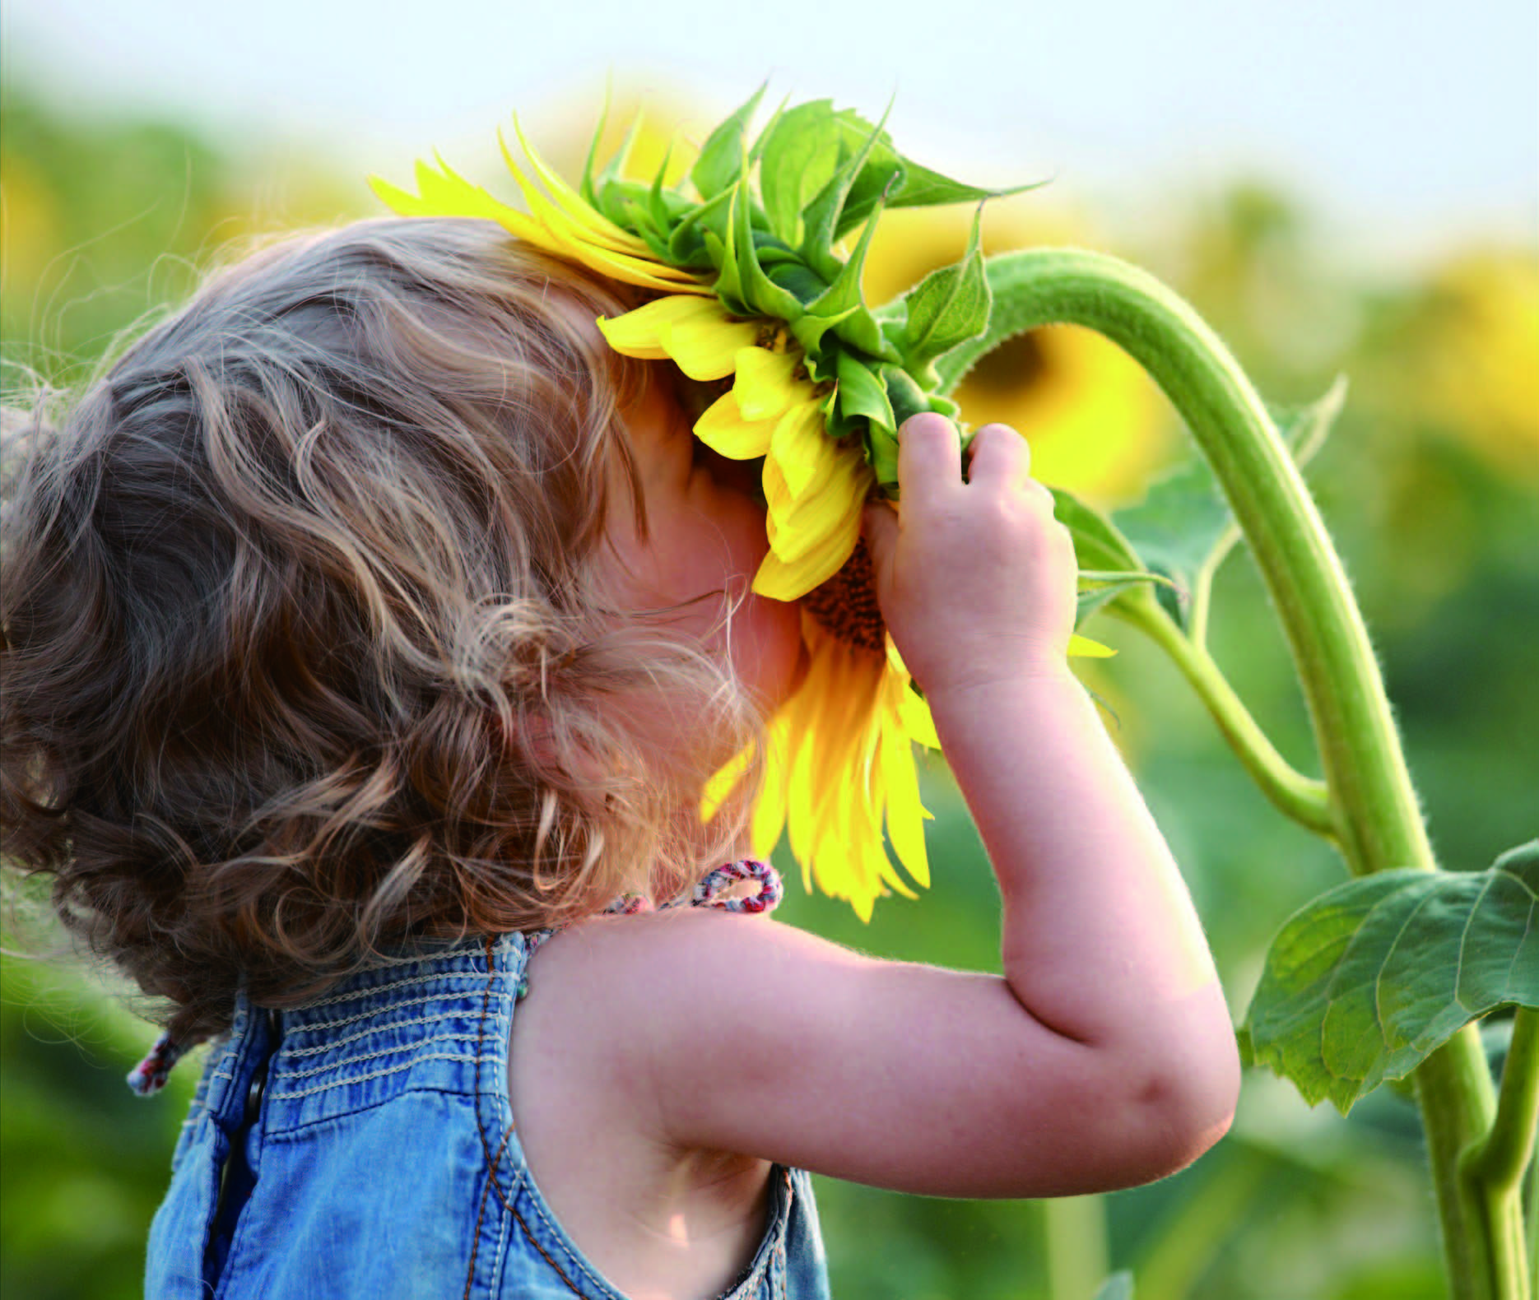
UNIT 3
Life moments

Slide 2
Unit 1 Traces of the past
Learning objectives
Opening up
Listening to the world
Speaking for communication
Further practice in listening
Wrapping up
Fun time

Slide 3

Learning objectives
1
talk about unusual experience
2
listen for time-order signal words and expressions
3
make phone calls
4
make a radio program on unusual experiences

Slide 4
Opening up
1
Read the questions and add three more questions.
1 Have you ever traveled abroad?
2 Have you ever slept in a tent in the woods?
3 Have you ever met a movie star?
4 Have you ever been to a festival / football match / rock concert?
5 Have you ever climbed a high mountain /ridden a horse /
missed the train?
6 Have you ever made a gift for your mother on her birthday?

Slide 5
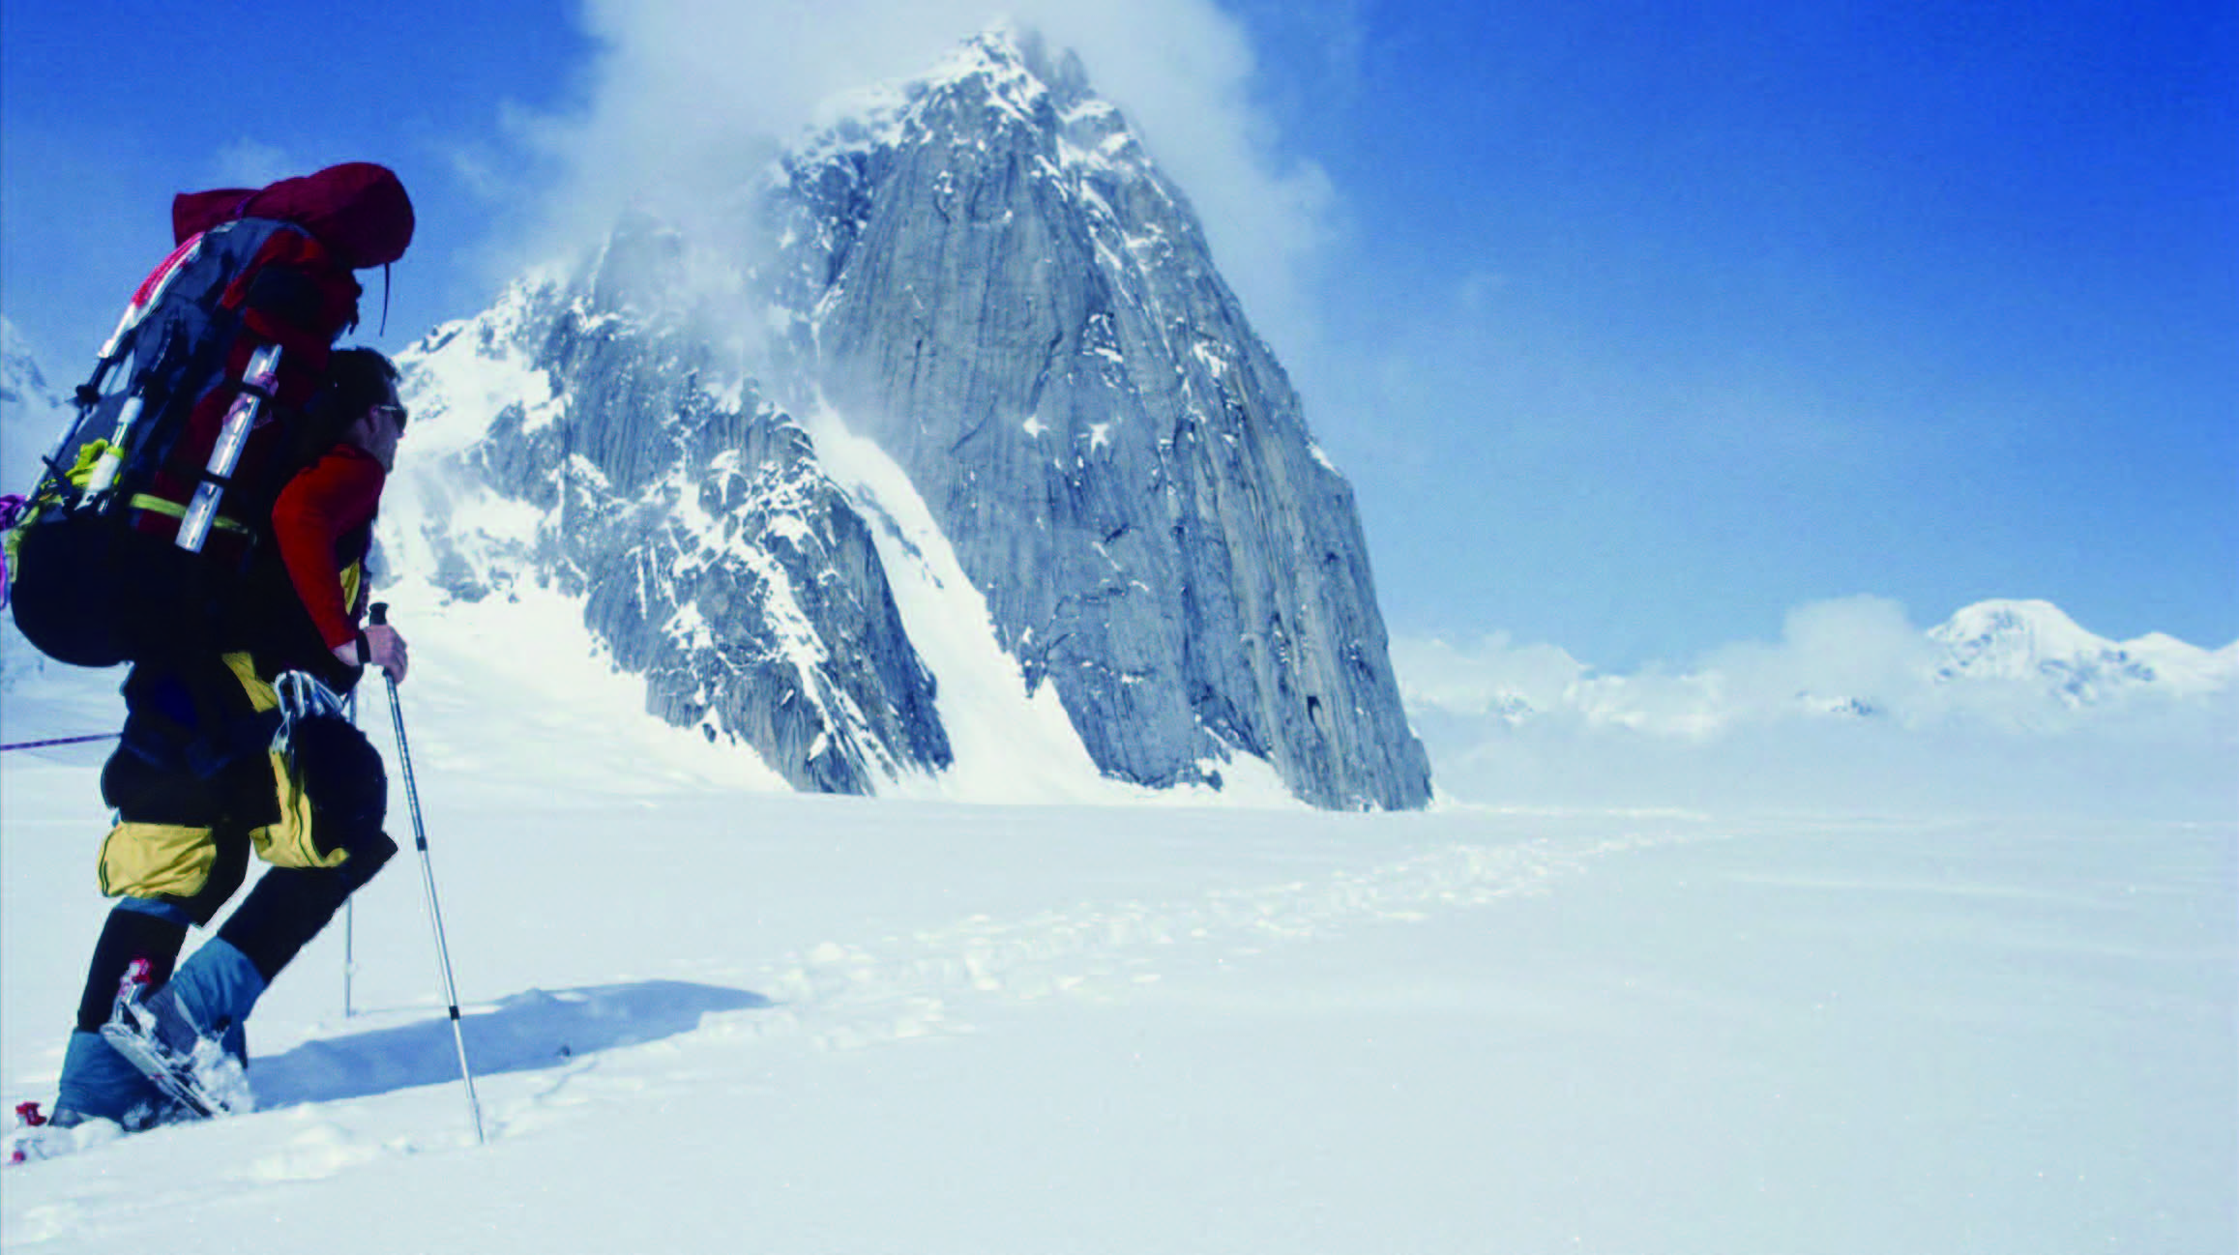
Opening up
2
Take turns to ask and answer the questions above. You may use the following pattern.
A: Have you ever climbed a high mountain?
B: Yes, I have. / No, I haven’t, but I’d like to go to one. / No, I haven’t and I don’t feel like going.

Slide 6
Listening to the world
Sharing
Listening
Viewing

Slide 7
Listening to the world
Sharing
1
Watch a podcast for its general idea.
The people in the podcast mainly talk about how
they feel about London and the most exciting
things they have done in London.
2
Watch Part 1 and answer the questions.
1 Why does Finn love living in London?
Because there’s so much to do.
2 What specific reasons does he give?
He has been to lots of interesting places but there’s always something new to experience.
3 What question does he ask people to answer?
How do you feel about London?

Slide 8
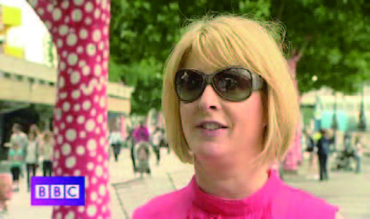
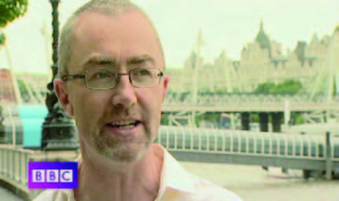
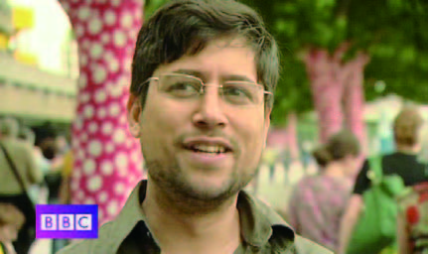
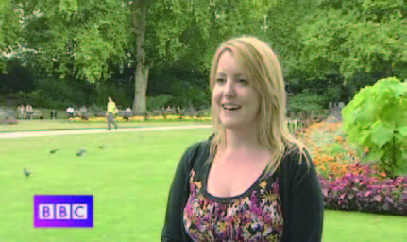
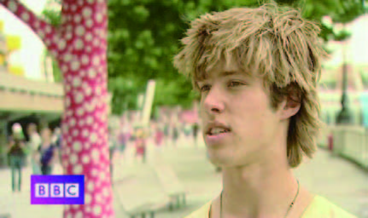
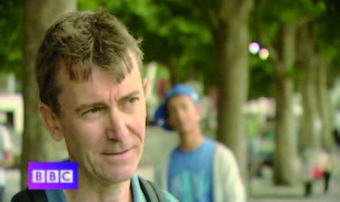
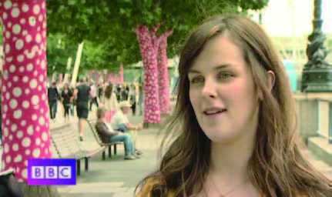
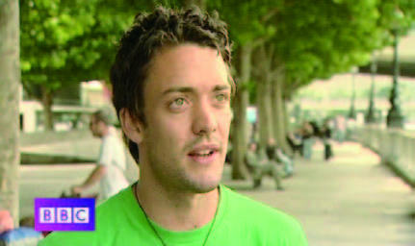
Listening to the world
Sharing
3
Watch Part 2 and match the statements.
1
2
A
C
3
4
H
B
5
6
G
F
7
8
D
E

Slide 9
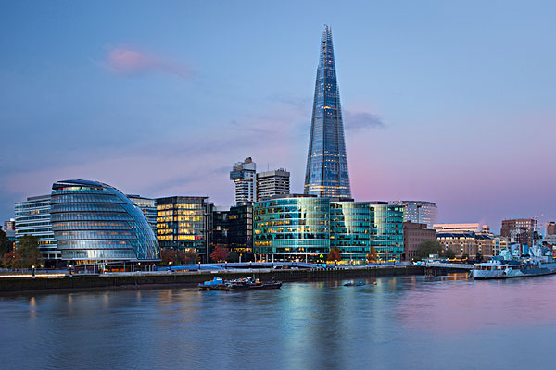
Listening to the world
Sharing
3
Watch Part 2 and match the statements.
Additional Notes
the South Bank: an area of London, located alongside the south bank of the River Thames. It is known as a place for arts and entertainment and stretches from the Design Museum in the east to the London Eye in the west. It now forms a major tourist district in central London.

Slide 10
Listening to the world
Sharing
4
Watch Part 3 and fill in the blanks.
1) exciting
2) amazing concert
3) incredible
4) the theater
5) the best place
6) different
7) compared to
8) play football
9) interesting things
10) the best thing
11) tickets
12) culture and sport

Slide 11
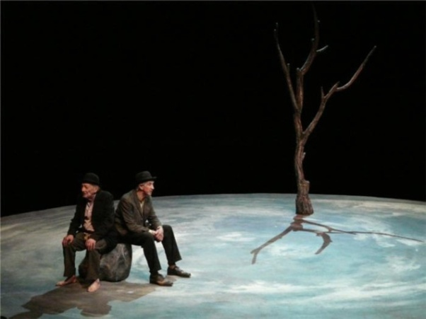
Listening to the world
Sharing
4
Watch Part 3 and fill in the blanks.
Additional Notes
 | Waiting for Godot an absurdist play(荒诞剧) by Samuel Beckett, in which two characters wait endlessly and in vain for the arrival of someone named Godot.
The two men say that they know Godot, but in fact, they hardly know him; and they admit that they would not recognize him if they were to see him. To kill time, they eat, sleep, talk, argue, sing, play games, and exercise. Godot’s absence, as well as various other aspects of the play, has caused many different interpretations. The play was voted “the most significant English language play of the 20th century”.

Slide 12
Listening to the world
Sharing
5
Discuss the questions.
1 Which city did you visit recently? What was the most exciting thing you did there?
Recently, I visited Beijing. Beijing is a wonderful city with many great things to do and see. I went to the National Center for the Performing Arts (国家大剧院) to see a famous musical. It was a wonderful show. And I visited the Bird’s Nest and the Water Cube, two important venues (场馆) of the 2008 Beijing Olympic Games. I also went to the Tian’anmen Square, the Forbidden City, the Temple of Heaven, Peking University, and the Summer Palace. But the most exciting thing I did there was visiting the Great Wall – the view was breathtaking!

Slide 13
Listening to the world
Sharing
5
Discuss the questions.
1 Which city did you visit recently? What was the most exciting thing you did there?
Yes, I have been to London. I loved it. The museums are wonderful, especially the British Museum, which was established in 1753 and is one of the largest and most comprehensive museums in the world. I also enjoyed riding in the London Eye, a giant observation wheel on the South Bank of the River Thames.
No, I haven’t been to London. If I have a chance to go to London, I would like to see places I have heard so much about, such as Tower Bridge, Tower of London, Buckingham Palace, Big Ben, and Westminster Abbey. I would also like to take the Tube as the London underground is the oldest underground railway network in the world. Besides, I hope to visit some of the2012 London Olympic Games venues.

Slide 14
Listening to the world
Sharing
Listening
Viewing

Slide 15
Listening to the world
Listening
Listening skills
Additional Tips
Listening for time-order signal words and expressions 1. Prepositional phrases with in, on, at, from ... to, by, for plus time are very common phrases of time order: • in March; in 2008; in the rainy season; in the morning / afternoon / evening; in the early 1940s • at Christmas; at Thanksgiving; at the end of the year; at the beginning of class • from Monday to Friday; from 2012 to 2014; from 5 o’clock to 9 o’clock • by the fifth day; by next weekend; by the end of last year • for about 10 minutes; for three hours; for more than two days

Slide 16
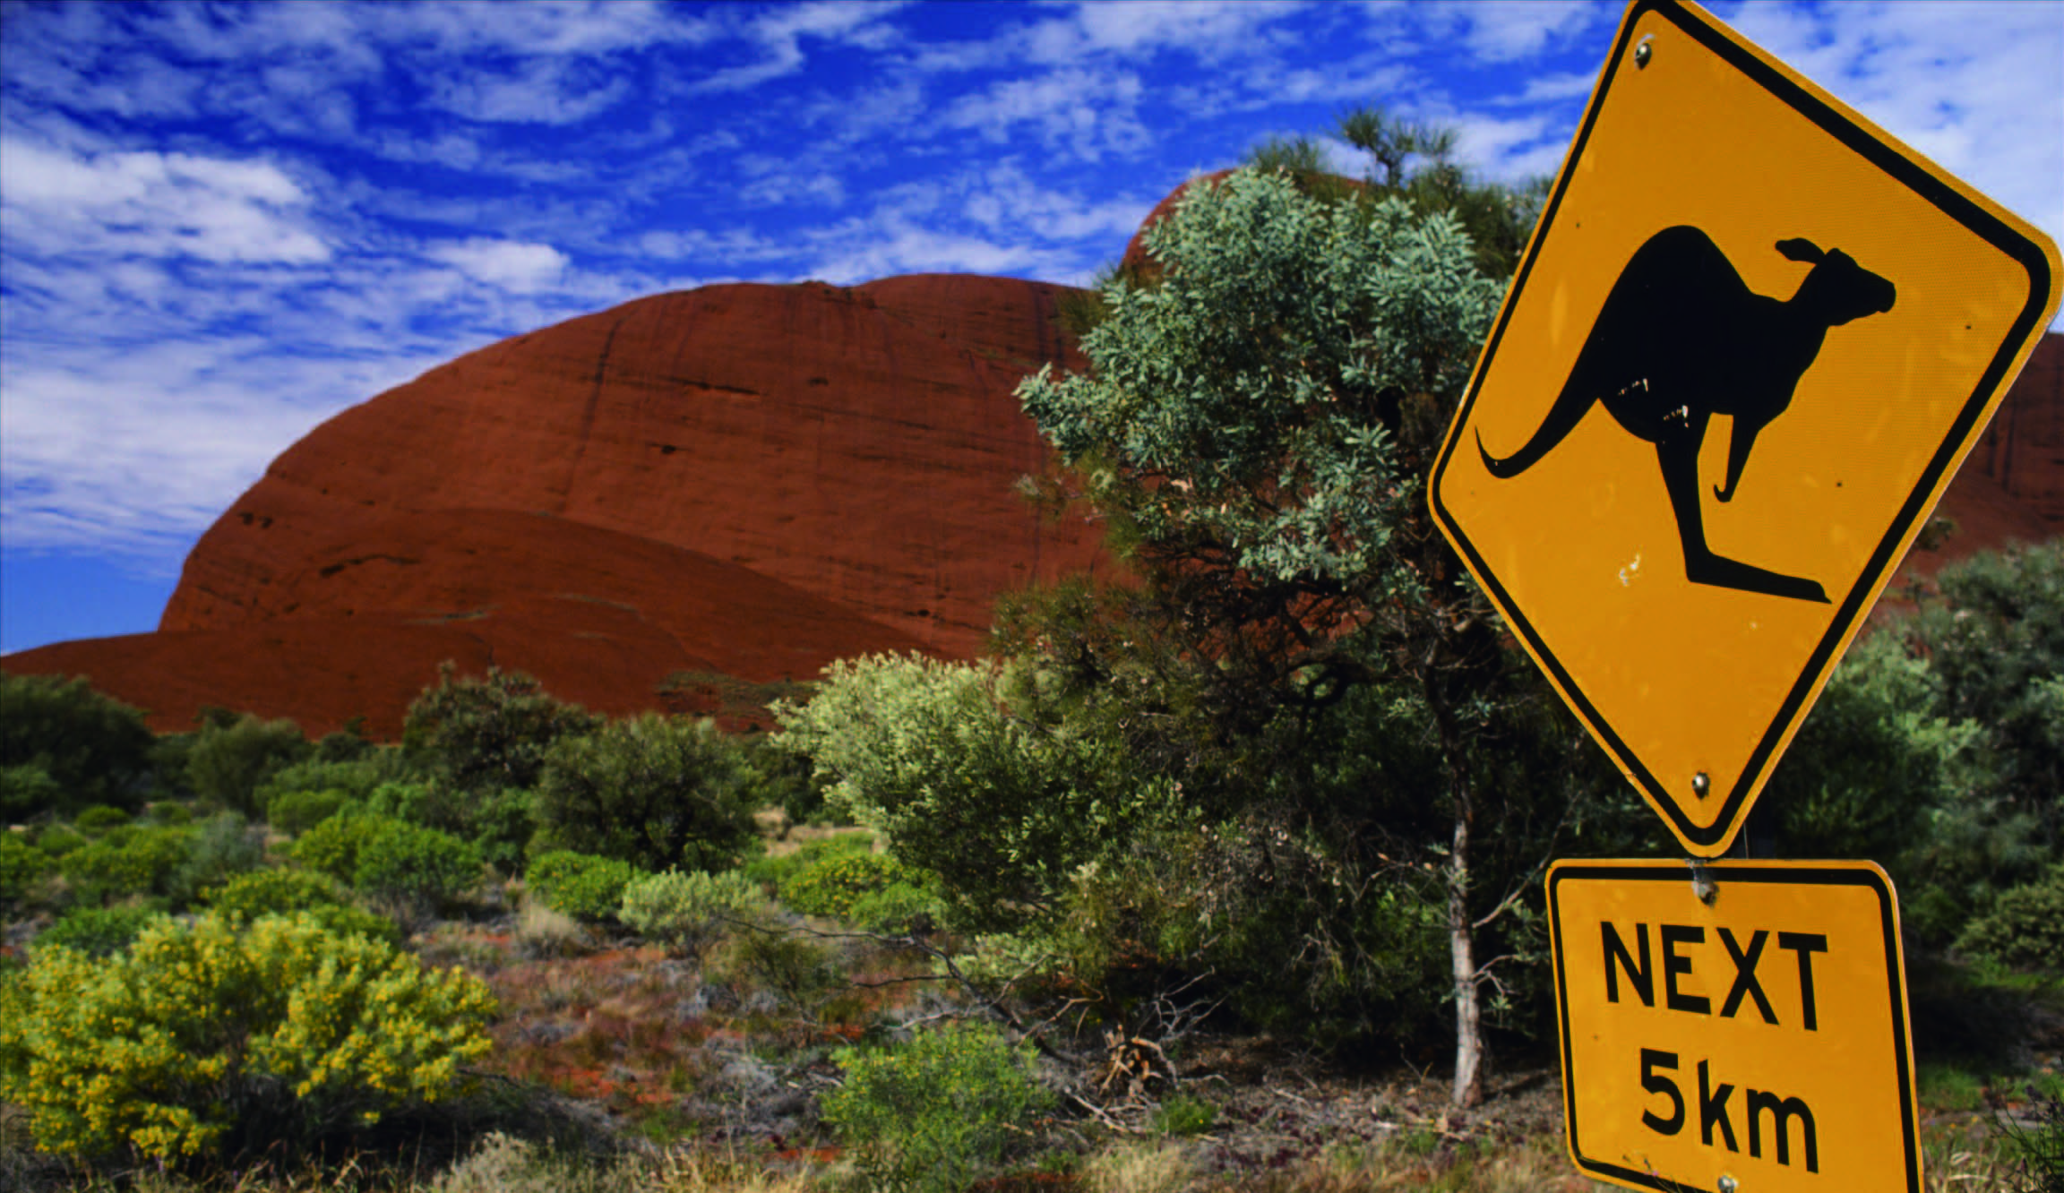
Listening to the world
Listening
Listening skills
Additional Tips
(continued) 2. Some expressions can signal the order of events in specific situations, but they are not fixed phrases like as soon as or in the end. You can create your own signal expressions based on the context. For example: two years ago; from that time on; at the age of 16; not long after that; a few minutes before we left home.

Slide 17

Listening to the world
Listening
BEFORE you listen
1
Read the statements about a man’s experience. Number them in the order you think they might happen.
2
Check your answers in Exercise 1.
a-d-h-e-b-g-c-f

Slide 18
Listening to the world
Listening
WHILE you listen
3
Listen to the talk again and answer the questions.
1 Where did it happen?
In Australia.
2 Why did the man think he was a bit stupid?
Because he decided to go further after he realized he didn’t know where he was.
3 How did the man feel when he saw the wild dogs coming toward him?
Really frightened.

Slide 19
Listening to the world
Listening
WHILE you listen
3
Listen to the talk again and answer the questions.
4 What advice did the man remember from his guidebook?
Don’t move, and don’t look at the dogs.
5 What did the man look at when the dogs were all around him?
A tree.

Slide 20
Listening to the world
Listening
After you listen
4
Work in pairs. Think about an exciting or a
frightening experience you’ve had and share it
with your partner.
When I was 12 years old and just graduated from elementary school, I went to Beijing with my dad to see the 2008 Olympic Games. I loved basketball, so I wanted to watch the Chinese basketball team playing and I especially wanted to see Yao Ming playing. First, we tried to buy tickets online, but all tickets for basketball games had been sold out. Of course, I was very disappointed. Then we went to the stadium to see if someone would be selling extra tickets. After we waited for hours, we became hopeless.

Slide 21
Listening to the world
Listening
After you listen
4
Work in pairs. Think about an exciting or a
frightening experience you’ve had and share it
with your partner.
But just when we were about to leave, a man came up to us and said he had an extra ticket because his friend couldn’t make it due to an emergency. We were overjoyed. Immediately, my dad bought the ticket, and told me to rush in – he would wait outside. Finally, I was able to watch the game between the Chinese team and the German team. I enjoyed the game greatly and I was excited when China won. The best thing was that I sawYao Ming. What a wonderful experience!

Slide 22
Listening to the world
Sharing
Listening
Viewing

Slide 23
Listening to the world
Viewing
BEFORE you view
1
Discuss the questions.
1 Have you ever been to a wedding? If yes, did you enjoy it? Why or why not?
Yes, I have been to a wedding. It was the wedding of my best friend’s sister. I enjoyed it very much because there was a lot of delicious food and I met a lot of friends there.

Slide 24
Listening to the world
Viewing
BEFORE you view
1
Discuss the questions.
2 Do you know anything about a traditional Chinese wedding? Mention at least three things.
Yes, I do. First, there is the ritual of bowing at traditional Chinese weddings. The bride and the groom bow to show their respect first to Heaven and Earth, then to their parents, and finally to each other. Second, there is always a huge wedding banquet. Family members and friends are invited to the wedding banquet. A huge amount of food is served along with liquor and wine. Third, the red color is used to create a happy atmosphere. Colors play a significant role in Chinese culture, both then and now. Red is the traditional wedding color as it signifies joy, love, and prosperity.

Slide 25
Listening to the world
Viewing
WHILE you view
2
Watch the video clip and check the true statements.
1 Preparations for traditional Cretan weddings often last for several weeks.
2 The whole of Maria’s village has turned out to see her get married.
3 The bride arrives with both her father and her mother.
4 The meat of 150 sheep was served at the wedding feast.
5 Maria and Jorgos’ first dance as man and wife includes all the guests.
days
✔
her father
✔
all the close family

Slide 26
Listening to the world
Viewing
WHILE you view
4
Watch the video clip again and answer the following questions.
1 What is special about Crete?
Crete is the biggest island in Greece.
2 How is the bride feeling?
She is a little nervous.
3 How many people are expected to go to the wedding?
All the women in the village are helping prepare the wedding feast.

Slide 27
Listening to the world
Viewing
WHILE you view
4
Watch the video clip again and answer the following questions.
1 What is special about Crete?
Crete is the biggest island in Greece.
2 How is the bride feeling?
She is a little nervous.
3 Who is helping with the wedding?
All the women in the village are helping prepare the wedding feast.

Slide 28
Listening to the world
Viewing
WHILE you view
4
Watch the video clip again and answer the following questions.
4 How many people are expected to go to the wedding?
About 1,500 people.
5 What do guests give to the bride and bridegroom as gifts?
They give money as gifts.
6 What does Francesco mean by saying “I’m destroyed”?
There is so much to see, do and eat at the wedding. Francesco is overwhelmed by all that.

Slide 29
Listening to the world
Viewing
AFTER you view
5
Discuss the questions.
1 Do you like the Greek wedding style? Why or why not?
I really like the Greek wedding style. I like the music and the dance very much. I can tell how excited people are and how much they enjoy the occasion. At a Greek wedding, people can gather together with their family, relatives, and friends, and fully enjoy music, dance, food and drink.
Not really. I don’t particularly like big noisy weddings. I prefer a smaller and quieter wedding. I would rather just invite my family and a few close friends to my wedding.

Slide 30
Listening to the world
Viewing
AFTER you view
5
Discuss the questions.
2 What kind of wedding would you like to have when you get married? Give your reasons.
I actually prefer not to have a wedding ceremony. I would like to have a honeymoon instead. Getting married should only involve two people. I hope I can enjoy the happiness without being disturbed by others. Another important reason why I want to skip the wedding is that preparing for a wedding is such a huge, exhausting, and time-consuming project.
I definitely like the modern Chinese wedding most because it not only has some traditional elements such as the red color, traditional wedding outfits, and the ritual of bowing, but also contains Western elements, including champagne, wedding rings, and a wedding cake.

Slide 31
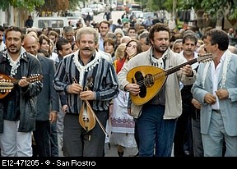
Listening to the world
Viewing
Additional Notes
Greek wedding In many parts of Greece, people hold a traditional wedding, and they usually play only traditional music and eat local food. In most traditional weddings, they bake whole animals. Traditionally, the whole village attends the wedding. A typical Greek wedding usually has 100 or more guests who are friends, brothers, sisters, grandparents, uncles, aunts, first or second cousins, neighbors and co-workers. It is common to have guests whom the couple have never met before.

Slide 32
Speaking for communication
Role-play
1
Listen to three phone conversations and complete the table.
 | Whom do they call | Why do they call
Caller 1
Caller 2
Caller 3
A friend
The caller has locked her keys in the car and calls her friend to get the spare key.
A service person
The caller has lost his credit card and calls the bank to report it.
A stranger
The caller has lost his cell phone and calls his own cell phone to see who has it.

Slide 33

Speaking for communication
Role-play
2
Listen to the conversations and fill in the blanks.
1) It’s
2) there
3) leave a message
4) Call
5) Speak
6) moment
7) Ring
8) number
9) this
10) picking up

Slide 34
Speaking for communication
Role-play
Speaking skills
Additional Tips
Making phone calls There are many kinds of situations that may occur in a phone conversation. It is important to know how to deal with them by getting familiar with the expressions that may be used in those situations.
What to do | What to say
Talk about the number | • Who number did you dial? • What’s your phone number, please? • I’m afraid you dialed the wrong number. • Oh sorry. I think I’ve dialed the wrong number. • Could you repeat the number, please?

Slide 35
Speaking for communication
Role-play
Speaking skills
Additional Tips
(continued)
What to do | What to say
Ask the other person to repeat | • Could you repeat that, please? • I’m sorry. I didn’t get what you just said. • Excuse me. I have trouble hearing you. Could you say that again? • I’m sorry. My English isn’t very good. Could you please say it again? • Would you mind spelling that for me, please?

Slide 36
Speaking for communication
Role-play
5
Role-play the situations.
Situation 1
Calling a friend
B: Hello.
A: Hello. May I speak to Xiao Ling, please?
B: May I ask who is speaking?
A: This is Mary, Xiao Ling’s friend.
B: Hi. I’m sorry, but Xiao Ling’s not in the dorm right now.
A: I tried calling her cell phone, but she didn’t answer the phone.
B: Oh, she has left her cell phone charging in the dorm.
A: OK. Where has she gone?
B: She has gone to the library. But she should be back very soon.

Slide 37
Speaking for communication
Role-play
5
Role-play the situations.
Situation 1
Continue
A: May I leave a message?
B: Certainly.
A: Please ask her to meet me at the theater at 7:30 in the evening. And I have already bought the tickets.
B: 7:30 at the theater. No problem. I’ll make sure she gets the message.
A: Thank you very much.
B: You are welcome. Goodbye.
A: Bye.

Slide 38
Speaking for communication
Role-play
5
Role-play the situations.
Situation 2
Calling customer services
B: Good morning. Customer services.
A: Good morning. I’ve got a problem. I’ve lost my bank card.
B: May I have your name, please?
A: My last name is Wang, and my first name is Xiaohai.
B: Mr. Wang, what is your ID number, please?
A: It’s 31486687.
B: Could you tell me when you lost your card?
A: I think I lost it last night. I used it in a restaurant last night. But this morning I couldn’t find it.
B: And your card number, please?
A: Just a moment. It’s 72588540395.

Slide 39
Speaking for communication
Role-play
5
Role-play the situations.
Situation 2
Continue
B: Please enter your PIN number.
A: OK.
B: OK. Your information is recorded. Your lost card is cancelled.
A: Then I need a new card. When do you think I can get one?
B: Generally, it takes four to six working days for the card to be ready.
A: Should I come to pick it up?
B: Yes. When the card is ready, we’ll call you. May I have your phone number?
A: My number is 4916664.
B: Let me check. It’s 4916664.
A: Correct.
……

Slide 40
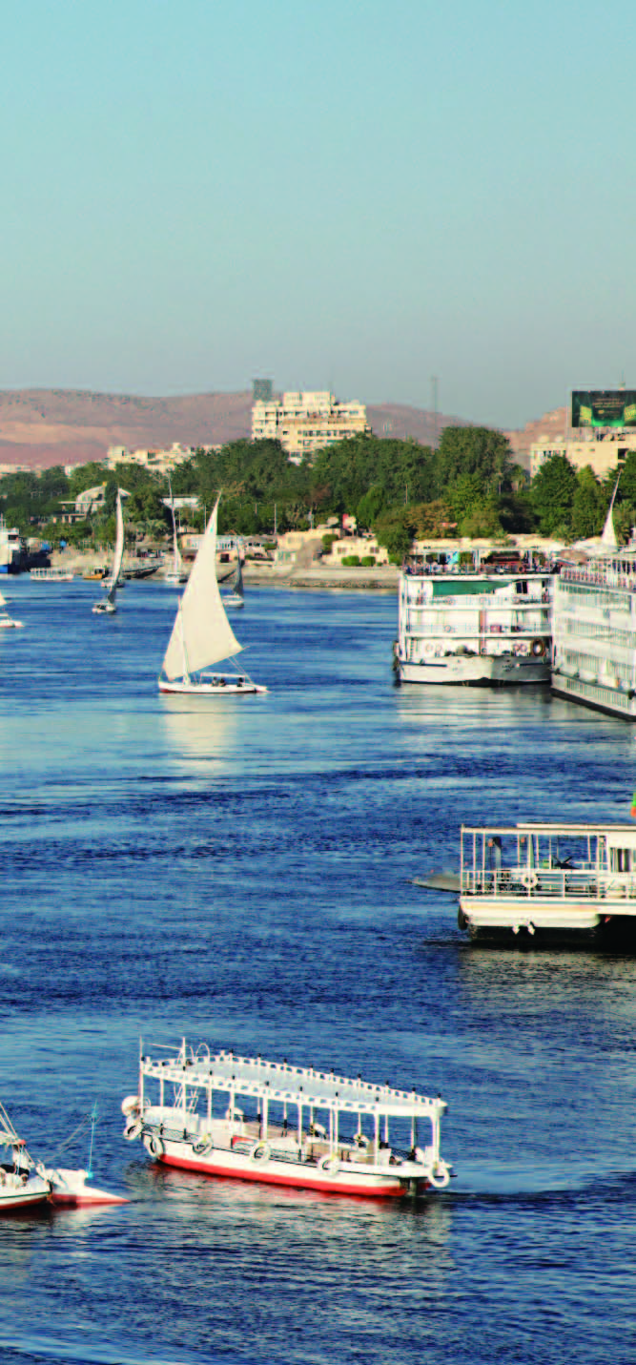
Speaking for communication
Group discussion
Get ideas
1
Check the activity each speaker has done.
Speaker 1: Climbing a volcano
Speaker 3: None of them
Speaker 2: Sailing down the Nile

Slide 41
Speaking for communication
Group discussion
Get ideas
2
Listen to the recording and check the ones you hear.
Interviewer
1 Excuse me. Do you have a second?
2 What has been the most unique experience in your life so far?
3 Can I show you this list? Um, have you done any of these activities?
4 We’re doing a survey ... about experiences of a lifetime.
5 Could you just look at this list? Have you done any of these things?
6 Would you like to try any of the activities listed here?
√
√
√
√

Slide 42
Speaking for communication
Group discussion
Get ideas
2
Listen to the recording and check the ones you hear.
Interviewee
7 Yes, yes, I have actually. Well, one of them!
8 No, no, I don’t think so.
9 I don’t travel that much, so … I, I haven’t been to Iceland.
10 If I have a chance, I would like to try that.
√
√
√

Slide 43
Speaking for communication
Group discussion
Discuss and organize ideas
3
Think about some questions you might ask in a survey about unusual experiences.
1 Have you ever taken a cruise on the Yangtze River? If yes, how did you feel? / If no, would you like to try it?
2 Have you ever been to Tibet? If yes, how did you feel? / If no, would you like to try it?
3 Have you ever camped in a forest? If yes, how did you feel? / If no, would you like to try it?

Slide 44
Speaking for communication
Group discussion
Discuss and organize ideas
4
Conduct the survey of your classmates’ or schoolmates’ unusual experiences. Record the survey.
Note: You may interview three to five of their classmates or schoolmates. You can record the interviews with your cell phone or a digital camera or a recording device. The survey should be conducted in English.

Slide 45
Speaking for communication
Group discussion
Discuss and organize ideas
5
Summarize your findings based on the survey and make a radio program on unusual experiences.
Note: Your radio program may cover information such as the purpose of the interview, number of interviewees and their backgrounds, activities the interviewees have done or have never done, and so on. You may play what they have recorded in the interviews.

Slide 46
Speaking for communication
Group discussion
Discuss and organize ideas
6
Present the program to the class
Hello, and welcome to Cool Entertainments. Recently we did a survey about people’s unusual experiences. We interviewed 12 people and asked them whether they have ever dived in the sea, done bungee jumping, or ridden on a roller coaster. And we also asked them if they have, how they felt, and if they haven’t, whether they would like to try any of the activities.

Slide 47
Speaking for communication
Group discussion
Discuss and organize ideas
6
(continued)
Here are our findings. Four of the interviewees have dived in the sea, and all of them regarded it as a wonderful experience. Only two of them have done bungee jumping; one found it very exciting while the other thought it too scary. Seven interviewees have ridden a roller-coaster; four of them enjoyed it while the other three felt it very scary and uncomfortable. Surprisingly, one person reports that he hasn’t done any of the three activities.

Slide 48
Speaking for communication
Group discussion
Discuss and organize ideas
6
(continued)
As to whether they would like to try any of the activities they haven’t done before, most of them say they would love to try diving in the sea or riding a roller-coaster, but only two people say they would try bungee jumping. The person who hasn’t tried any of the activities says he will never try any of them because they all sound very dangerous.

Slide 49
Speaking for communication
Group discussion
Discuss and organize ideas
6
(continued)
It was very interesting to hear people talk about their unusual experiences. We hope that they will continue to have more special and exciting experiences in the future.

Slide 50
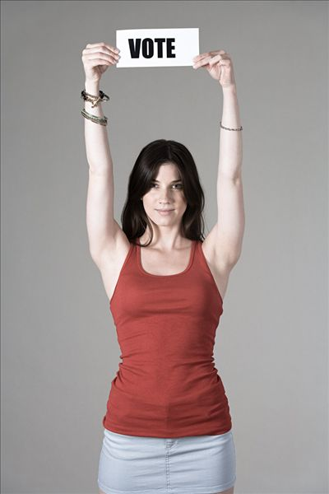
Speaking for communication
Group discussion
Discuss and organize ideas
7
Vote for the most interesting radio program.

Slide 51
Further practice in listening
Short conversations
1 Q: Why didn’t the man go to the concert?
C He was too sick to go.
2 Q: What can we learn about Jennifer’s job interview?
C She didn’t feel like talking about the interview.
3 Q: What will the man probably do?
B He will give the bicycle back right now.
4 Q: What are the speakers talking about?
D Meeting former classmates.
5 Q: What does the man mean?
A He totally understands the woman’s situation.

Slide 52
Further practice in listening
Long conversation
1 Q: Why was the girl excited?
B She won the spelling competition at her school.
2 Q: What happened when the man was 13 years old?
C He went to Sacramento for a spelling competition.
3 Q: Why did the man’s mom give him a big hug?
A To make him feel better after he lost the first prize.
4 Q: What color is the girl going to wear for her next competition?
D Yellow.

Slide 53
Further practice in listening
Passage 1
1 Q: What is the passage mainly about?
C Superstitions in the United States.
2 Q: According to the passage, what is considered as bad luck?
A Walking under a ladder.
3 Q: Why is it considered bad luck to see a black cat crossing one’s path?
B Because black cats were thought to be witches.
4 Q: According to the passage, what will bring people good luck?
C Finding a penny on the ground and picking it up.

Slide 54
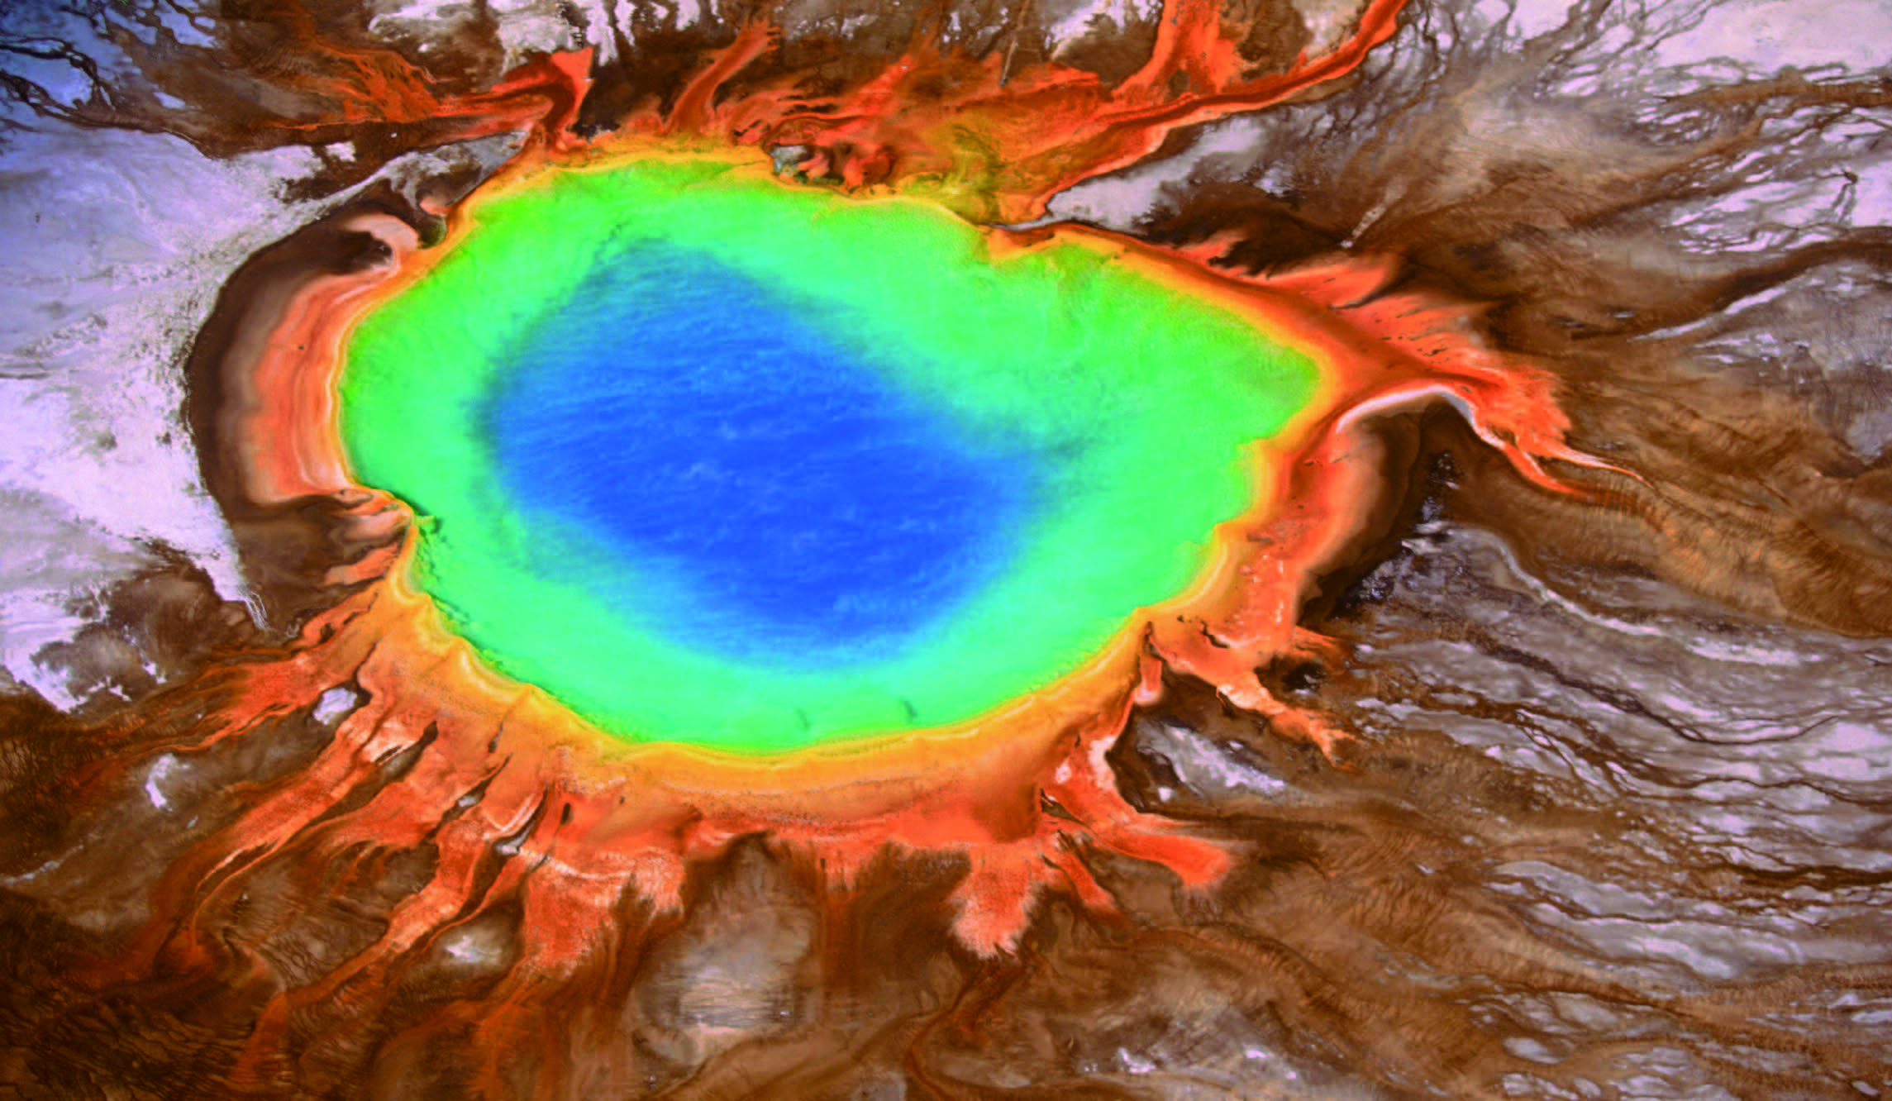
Further practice in listening
Passage 2
1) mountainous
2) frightened
3) took place
4) vanish
5) occurred
6) massive
7) caught
8) keep us away
9) grateful
10) In advance

Slide 55
Wrapping up
Use the following self-assessment checklist to check what you have learned in this unit.
 | OK | Needs work
I can talk about past events and their impacts on the present.
I can listen for specific information.
I can keep a conversation going by asking follow-up questions, giving extra information and making comments.
I can prepare questions for an interview and conduct the interview.

Slide 56
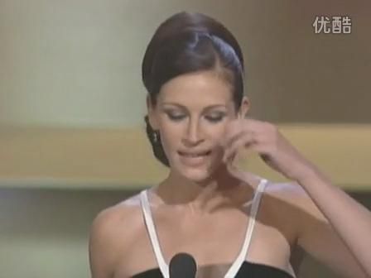

Fun time
Enjoy the video clip about Julia Roberts’ winning an Oscar.

